Slide 1
WSDL - WEB SERVICES DESCRIPTION LANGUAGE

Slide 2
LIST OF TOPICS
WSDL Description
WSDL Elements
  Definition
  Type
  Message
  Port type
  Binding
  Port
  Service
  WSDL 1.0 and 2.0
  Summary

Slide 3
WSDL DESCRIBES WEB SERVICES
WSDL stands for Web Services Description Language.
WSDL is a document written in XML. The document describes a Web service. It specifies the location of the service and the operations (or methods) the service exposes.
A WSDL description of a web service (also referred to as a WSDL file) provides a machine-readable description of how the service can be called what parameters it expects and what data structures it returns.
WSDL was developed jointly by Microsoft and IBM initially.
WSDL is pronounced as 'wiz-dull' and spelled out as 'W-S-D-L'

Slide 4
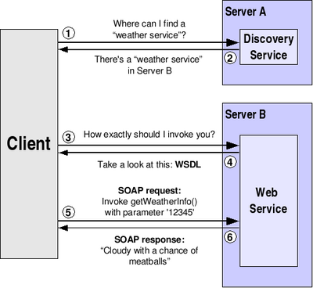
WSDL EXAMPLE

Slide 5
STRUCTURE OF A WSDL DOCUMENT
<definitions>
<types>
definition of types........
</types>
<message>
definition of a message....
</message>
<portType>
<operation>
definition of a operation.......
</operation>
</portType>
<binding>
definition of a binding....
</binding>
<service>
definition of a service....
</service>
</definitions>
A WSDL document has various elements, but they are contained within these main elements, which can be developed as separate documents and then they can be combined or reused to form complete WSDL files.

Slide 6
WSDL ELEMENTS OVERVIEW
Definition: Element must be the root element of all WSDL documents. It defines the name of the web service, declares multiple namespaces used throughout the remainder of the document and contains all the service elements described here.
Data types: the data types - in the form of XML schemas or possibly some other mechanism - to be used in the messages
Message: An abstract definition of the data in the form of a message presented either as an arguments to be mapped to a method invocation.
Operation: An abstract definition of the operation for a message such as naming a method, message queue or business process that will accept and process the message
Port type : An abstract set of operations mapped to one or more end points, defining the collection of operations for a binding

Slide 7
WSDL ELEMENTS OVERVIEW (CONT..)
Binding: the concrete protocol and data formats for the operations and messages defined for a particular port type.
Port: a combination of a binding and a network address, providing the target address of the service communication.
Service: a collection of related end points encompassing the service definitions in the file.

Slide 8
WSDL ELEMENTS
<definition> Element : It must be the root element of all WSDL documents. It defines the name of the web service.
  <definitions name="HelloService"
  targetNamespace="http://www.examples.com/wsdl/HelloService.wsdl" xmlns="http://schemas.xmlsoap.org/wsdl/"
  xmlns:soap="http://schemas.xmlsoap.org/wsdl/soap/" xmlns:tns="http://www.examples.com/wsdl/HelloService.wsdl" xmlns:xsd="http://www.w3.org/2001/XMLSchema"> .........................
  </definitions>
  <Type> Element:
    A Web service needs to define its inputs and outputs and how they are mapped into and out of services. WSDL <types> element take care of defining the data types that are used by the web service.
    It describes all the data types used between the client and server.
    WSDL uses the W3C XML Schema specification as its default choice to define data types
    If the service uses only XML Schema built-in simple types, such as strings and integers, then types element is not required (Refer HelloService.wsdl)

Slide 9
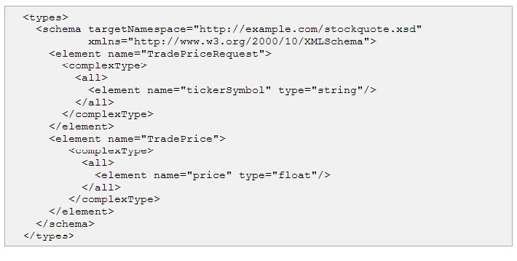
TYPE ELEMENTS CONT…
WSDL allows the types to be defined in separate elements so that the types are reusable with multiple Web services.

Slide 10
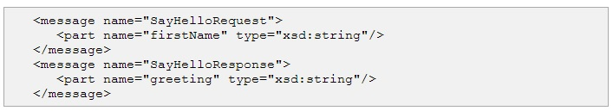
ELEMENTS CONT…
<message> Element:
  It describes the data being exchanged between the Web service providers and consumers.
  Each Web Service has two messages: input and output.
  The input describes the parameters for the Web Service and the output describes the return data from the Web Service.
  Each message contains zero or more <part> parameters, one for each parameter of the Web Service's function.
  Each <part> parameter associates with a concrete type defined in the <types> container element.

Slide 11
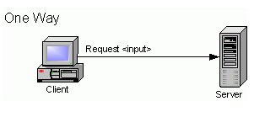
ELEMENTS CONT…
<portType> Element: It combines multiple message elements to form a complete one-way or round-trip operation.
One-way :
The service receives a message. The operation therefore has a single input element.
which is the client's request to the server. No response is expected.
<operation name="weatherUpdate">
<input message="tns:weatherUpdate"/>
</operation>
<message name="weatherUpdate">
<part name="weatherData" type="wsx:WeatherSummary"/>
</message>

Slide 12
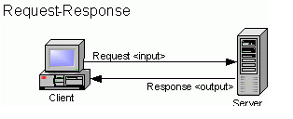
PORTTYPE ELEMENTS CONT…
Request-response:
The service receives a message and sends a response. The operation therefore has one input element, followed by one output element.
<operation name="subscribe">
<input message="tns:subscribe"/>
<output message="tns:subscribeResponse"/>
</operation>
<message name="subscribe">
<part name="host" type="xsd:string"/>
<part name="port" type="xsd:string"/>
<part name="transportName" type="xsd:string"/>
</message>

Slide 13
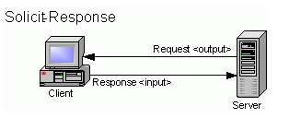
PORTTYPE ELEMENTS CONT…
Solicit-response:
The solicit-response operation includes one output element, which is the server's request to the client, followed by one input element, which is the client's response back to the server.
<operation name="verifySubscription">
<output message="tns:verifySubscription"/>
<input message="tns:verifySubscriptionResponse"/>
</operation>
<message name="verifySubscriptionResponse">
<part name="status" type="xsd:boolean"/>
</message>

Slide 14
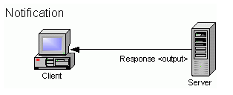
PORTTYPE ELEMENTS CONT…
Notification :
The service sends a message. The operation therefore has a single output element.
<operation name="weatherNotification">
<output message="tns:weatherNotification"/>
</operation>
<message name="weatherNotification">
<part name="weatherData" type="wsx:WeatherSummary"/>
</message>

Slide 15
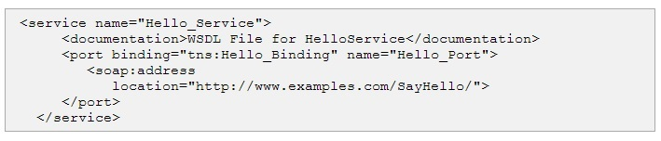
ELEMENTS CONT…
<port> element:
  The port element has two attributes - the name attribute and the binding attribute.
  The name attribute provides a unique name among all ports defined within in the enclosing WSDL document.
  The binding attribute refers to the binding using the linking rules defined by WSDL.
  Binding extensibility elements (1) are used to specify the address information for the port.
  A port MUST NOT specify more than one address.
  A port MUST NOT specify any binding information other than address information.

Slide 16
ELEMENTS CONT…
<binding> element
  provides specific details on how a portType operation will actually be transmitted over the wire.
  The bindings can be made available via multiple transports, including SOAP over HTTP GET, HTTP POST
  The bindings provide concrete information on what protocol is being used to transfer portType operations.
  The bindings provide information where the service is located.
  For SOAP protocol, the binding is <soap:binding>, and the transport is SOAP messages on top of HTTP protocol.
  You can specify multiple bindings for a single portType.
<binding name="Hello_Binding" type="tns:Hello_PortType">
The name attribute defines the name of the binding, and the type attribute points to the port for the binding, in this case the "tns:Hello_PortType" port.

Slide 17
BINDING ELEMENTS CONT…
SOAP Binding
WSDL 1.1 includes built-in extensions for SOAP 1.1. This enables you to specify SOAP specific details, including SOAP headers, SOAP encoding styles, and the SOAPAction HTTP header. The SOAP extension elements include:
soap:binding
This element indicates that the binding will be made available via SOAP. The style attribute indicates the overall style of the SOAP message format. A style value of rpc specifies an RPC format.
The transport attribute indicates the transport of the SOAP messages. The value http://schemas.xmlsoap.org/soap/http indicates the SOAP HTTP transport, whereas http://schemas.xmlsoap.org/soap/smtp indicates the SOAP SMTP transport.
soap:operation
This element indicates the binding of a specific operation to a specific SOAP implementation. The soapAction attribute specifies that the SOAPAction HTTP header be used for identifying the service.

Slide 18
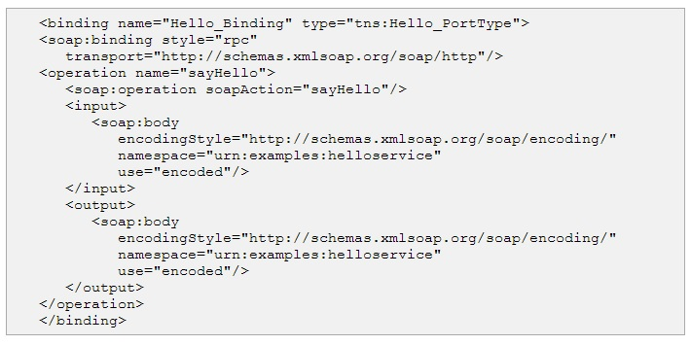
BINDING ELEMENTS CONT…
soap:body
This element enables you to specify the details of the input and output messages. In the case of HelloWorld, the body element specifies the SOAP encoding style and the namespace URN associated with the specified service.

Slide 19
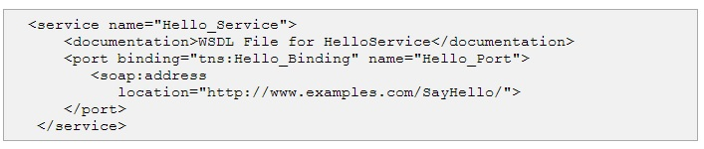
ELEMENTS CONT…
<service> Element:
  Defines the ports supported by the Web service. For each of the supported protocols, there is one port element. The service element is a collection of ports.
  Web service clients can learn from the service element where to access the service, through which port to access the Web service, and how the communication messages are defined.
  The service element includes a documentation element to provide human-readable documentation.

Slide 20
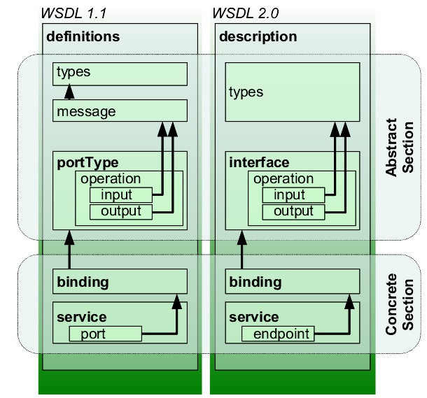
WSDL 1.1 AND 2.0 DIFFERENCE

Slide 21
DIFFERENCE BETWEEN 1.1 AND 2.0
WSDL 1.1 Term | WSDL 2.0 Term | Description
Service | Service | Contains a set of system functions that have been exposed to the Web-based protocols.
Port | Endpoint | Defines the address or connection point to a Web service. It is typically represented by a simple HTTP URL string.
Binding | Binding | Specifies the interface and defines the SOAP binding style (RPC/Document) and transport (SOAP Protocol). The binding section also defines the operations.
PortType | Interface | Defines a Web service, the operations that can be performed, and the messages that are used to perform the operation.
Operation | Operation | Defines the SOAP actions and the way the message is encoded, for example, "literal." An operation is like a method or function call in a traditional programming language.

Slide 22
DIFFERENCE CONT…
Message | n/a | Typically, a message corresponds to an operation. The message contains the information needed to perform the operation. Each message is made up of one or more logical parts. Each part is associated with a message-typing attribute. The message name attribute provides a unique name among all messages. The part name attribute provides a unique name among all the parts of the enclosing message. Parts are a description of the logical content of a message. In RPC binding, a binding may reference the name of a part in order to specify binding-specific information about the part. A part may represent a parameter in the message; the bindings define the actual meaning of the part. Messages were removed in WSDL 2.0, in which XML schema types for defining bodies of inputs, outputs and faults are referred to simply and directly.
Types | Types | Describes the data. The XML Schema language (also known as XSD) is used (inline or referenced) for this purpose.

Slide 23
WSDL 2.0
WSDL 2.0 became a W3C recommendation on June 2007. WSDL 1.2 was renamed to WSDL 2.0 because it has substantial differences from WSDL 1.1. The changes are the following:
Added further semantics to the description language
Removed message constructs
Operator overloading not supported
PortTypes renamed to interfaces
Ports renamed to endpoints

Slide 24
WSDL AND UDDI
Universal Description, Discovery and Integration (UDDI) is a directory service where businesses can register and search for Web services.
What is UDDI
UDDI is a platform-independent framework for describing services, discovering businesses, and integrating business services by using the Internet.
UDDI is a directory for storing information about web services
UDDI is a directory of web service interfaces described by WSDL
UDDI communicates via SOAP

Slide 25
WHAT IS UDDI BASED ON?
UDDI uses World Wide Web Consortium (W3C) and Internet Engineering Task Force (IETF) Internet standards such as XML, HTTP, and DNS protocols.
UDDI uses WSDL to describe interfaces to web services
Additionally, cross platform programming features are addressed by adopting SOAP, known as XML Protocol messaging specifications found at the W3C Web site

Slide 26
WHO IS SUPPORTING UDDI?
UDDI is a cross-industry effort driven by all major platform and software providers like Dell, Fujitsu, HP, Hitachi, IBM, Intel, Microsoft, Oracle, SAP, and Sun, as well as a large community of marketplace operators, and e-business leaders.
Over 220 companies are members of the UDDI community.

